Slide 1
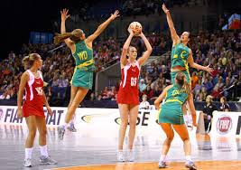
SPORT
Sport, e-sport, physical education, physical recreation are man-made activities designed to do what people want them to do.

Slide 2
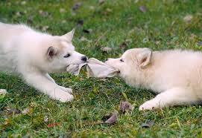
Born to play
Contrastingly `play’ is a natural well designed product of nature, designed to do what people need rather than what people want in order to fulfil basic evolutionary functions effectively
play enables us to interact naturally with the environment in which we find ourselves.

Slide 3
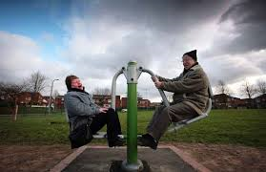
Accessible
Play is available to everyone, young, old, able, disabled, male or female.

Slide 4
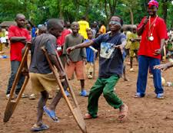
Inclusive
Importantly play is not a separate activity but can be an integral part of existing activities.

Slide 5

Partnership
Play should be understood and applied in partnership with each activity rather than in isolation.

Slide 6
Quality experience
The quality of the experience rather than the activity itself is fundamental to the success of applying play to sport, physical activities and indeed sedentary activities.
It is important that as providers we recognise some of the key ingredients or characteristics of play that we may need to trigger in order to create this quality experience.

Slide 7
What are the key characteristics of play?
> Physical activity
> Explorer
> Competitor
> Storyteller
> Joker
> Organiser
> Collector
> Artist / creator

Slide 8
Fundamental
Play enables us to interact naturally with the environment in which we find ourselves.
Therefore it would seem reasonable to assume that it would be sensible to create a positive conducive environment in which to play.

Slide 9
Where Next? - IT Paradigm
Today information technology is central to almost every aspect of human lives from communication and mobility to the way people spend their leisure time.
Today sport and physical activity have a competitor for peoples play time or put another way play has a choice available to it that was not available to young people in 1951

Slide 10
Electronic Sport
Electronic sport and gaming is a growing cultural phenomenon that is redefining existing spatial relations through new processes of place construction and virtual connections in an increasingly placeless world.
E Sports and gaming is an extremely unique cultural phenomenon in terms of its spatial relation with society.
E sports and gaming is reorganising the boundaries between technology and social activity.

Slide 11
Cyber Athletes
Today computer E- Sport Gamers have the ability to become `cyber athletes’ in which competing in global tournaments around the world is a viable profession.
In 2014, 19 professional teams competed at the Dota 2 tournament for $10,925,085, prize money, eclipsing the prize money of the 2014 Masters Golf Tournament

Slide 12
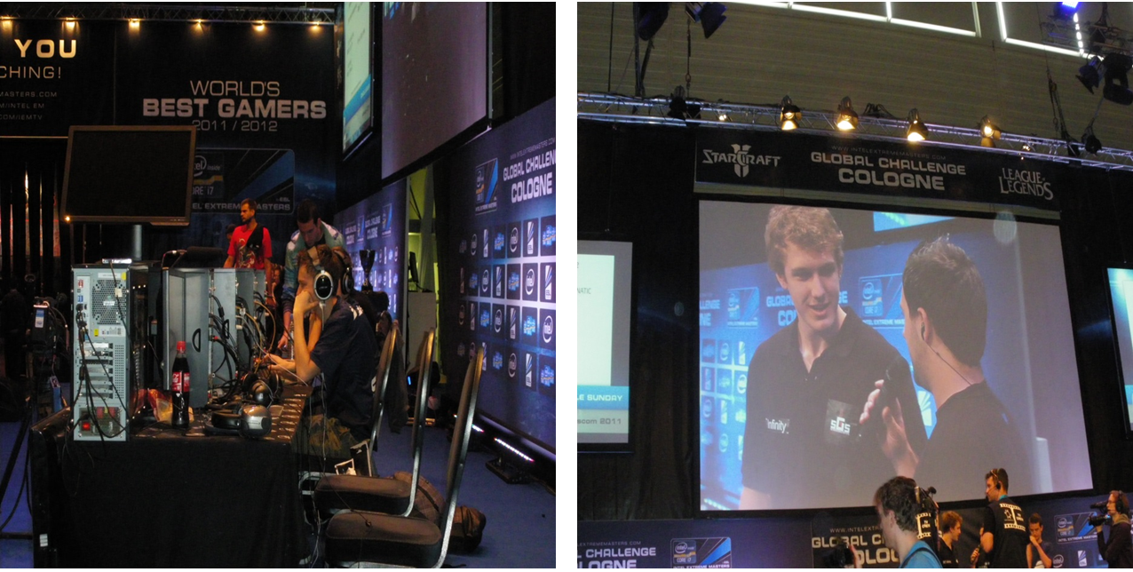

Slide 13
Place and space
Place is space that people invest meaning into and become attached to in one form or another.
Today society is increasingly redefining our understanding of places as virtual and physical realities.
Virtual communities being able to bring people together around shared interests, with communities developing into physical realities through happenings like competitive meets, social meet ups and material and merchandise support for members.

Slide 14
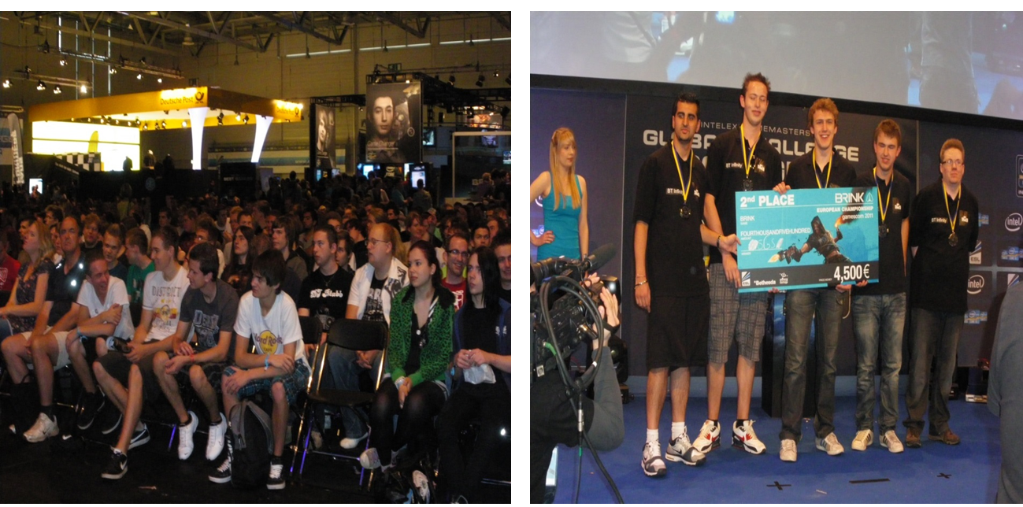

Slide 15

Physical Activity.
The child who likes to fight, chase, build dens, play hide and seek.
Earliest mans skill acquisition enabling to hunt, protect and generally survive.
Needs to be challenging, free, stimulating.
Needs to suit the stage of development an individual is at.
Needs to be appropriate to the ability level
of the individual.

Slide 16
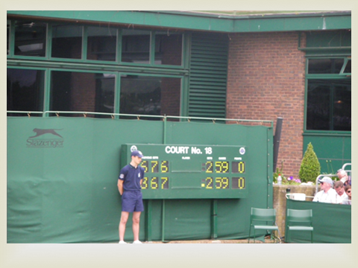
Competitor
Starts at an early stage often between siblings, peers, family members for love, recognition and attention.
Evolves into all walks of life including sport, business, quizzes, exams, politics.
Can compete as an individual or in a group
Competition in the wrong hands can be dangerous

Slide 17
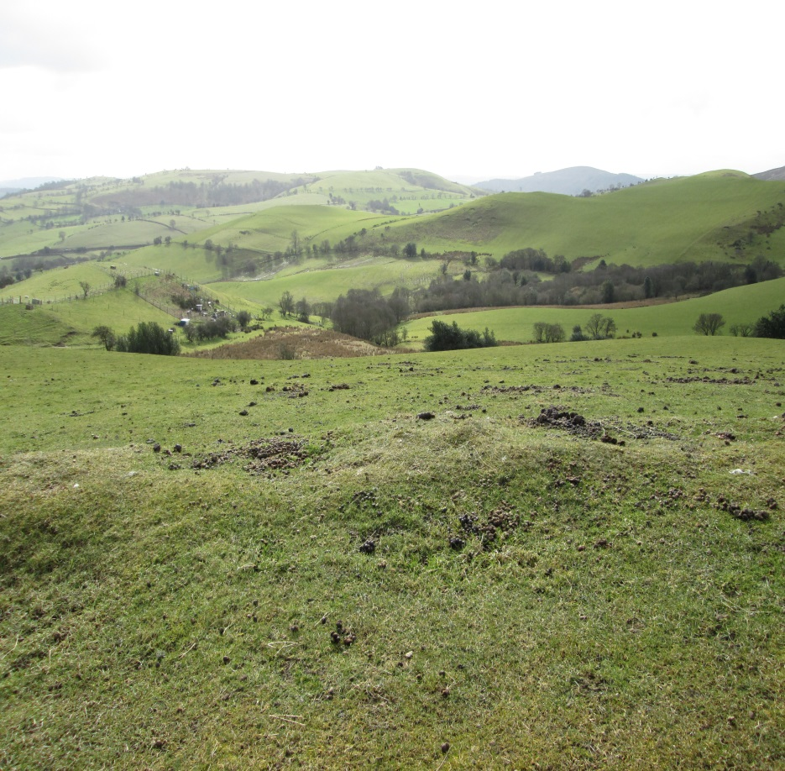
Explorer
Early in life we start exploring the immediate environment we find ourselves.
Physical can be visiting and exploring new places, new experiences, a deepening of the familiar, through music, art, sport, business
Mental can be in a study, at home or work through technology, experiences, fantasies, researching new subject areas
What we explore how far we explore evolves throughout the life cycle as we develop

Slide 18
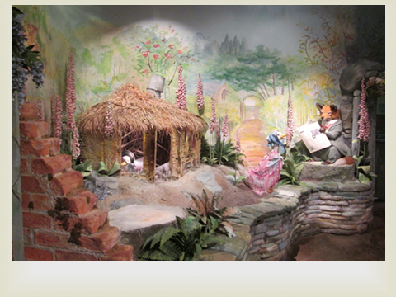
Storyteller
Imagination is the key to play for the storyteller
Because of this play can be brought to almost any activity.
We have created outlets for the storyteller though dance, acting, magic, comedy the outdoors, sport
It creates its own space and place

Slide 19
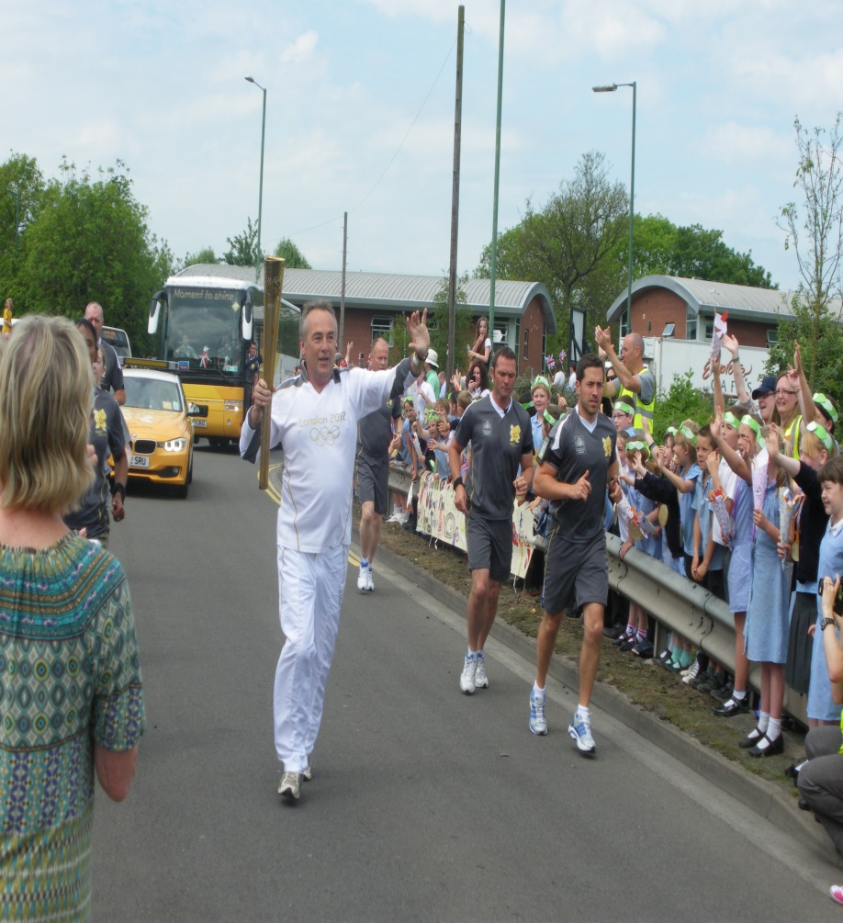
The Organiser
Enjoyment from planning and doing
Starts with building and caring in the family home local community
Some have more aptitude than others to organise, direct or manage
Usually applied to a specialist area of knowledge
for fun and enjoyment whether at work, in the world of art, sport or beyond

Slide 20

Collector
To have and to hold to collect a set of objects or experiences.
Coins, toys antiques, major events, badges, records, books, Numbers for example.
Can be done as a solitary activity or with others who share similar passions

Slide 21
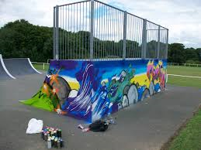
Artist / Creator
The making of things, painting, writing, music, drama, landscaping, gardening, design.
Maybe create from nothing, restore, repair, clean.
Through natural environment or use of art and craft materials or play materials like lego, use of technology

Slide 22
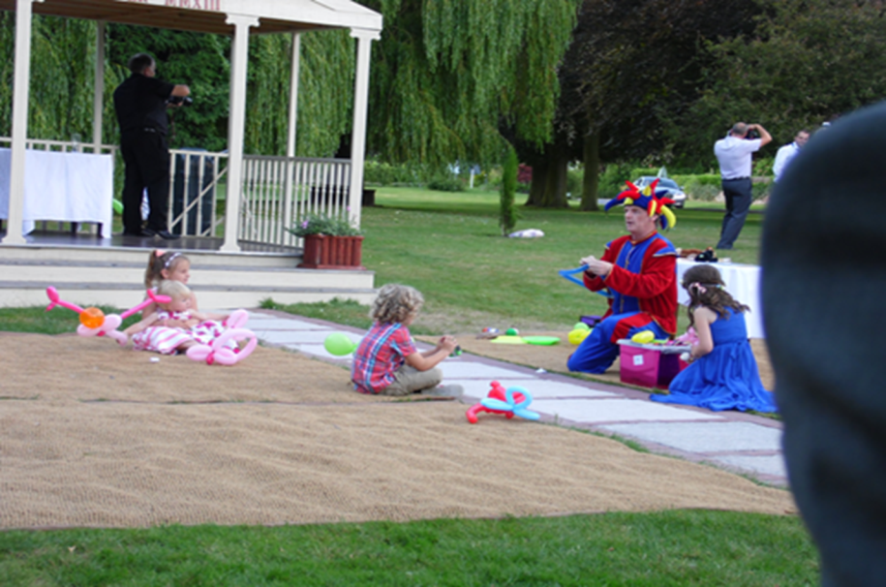
Joker
Early childhood – funny sounds, funny faces evolves and develops often through physical actions, or use of words.
Jokers need to be encouraged
Important person in group dynamics
Need to be able to express themselves
Characters in stories
Characters in teams

Slide 23
Play has a continuative desire
Play is repetitive
Offers great potential to foster and use this quality in relation to sport and physical activity.
Ability to do something again and again for long periods of time.
In terms of increasing frequency, intensity and duration these qualities look very attractive to those responsible for delivery across our communities.

Slide 24
Finally - All that we ask of you today
Is to consider putting the play `x’ factor into your design, your management, your maintenance projects.
Apply `play’ to all that you do
See where it leads
Thank-you for listening
David Kilby:

